Slide 1


Ramzy 3ada wane 3la elma5da

Slide 2
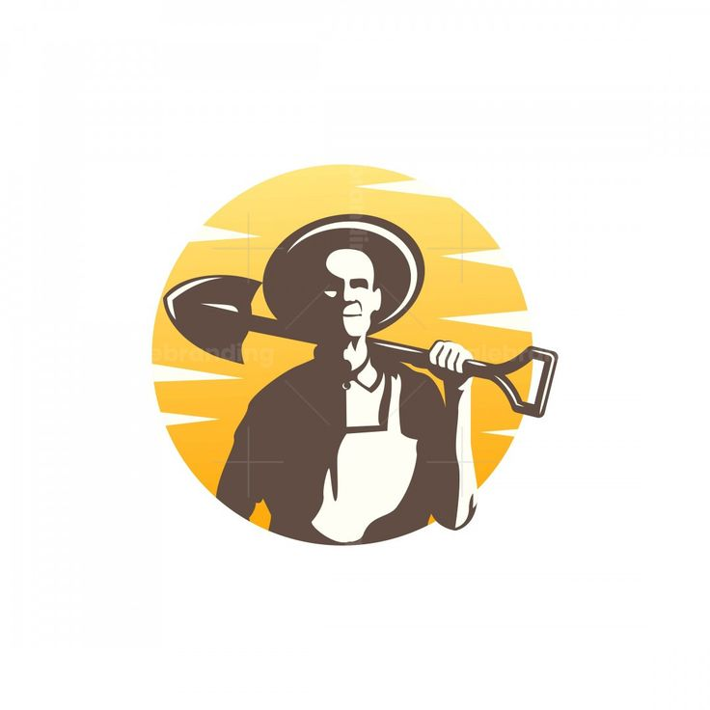
Mostafa Ashraf
Youssef Rayhan
Wafaa Gamal
Ahmed Ramzy
Under Supervision Of:
DR: Asmaa Saad && ENG: Juma El Mokhtar

Slide 3
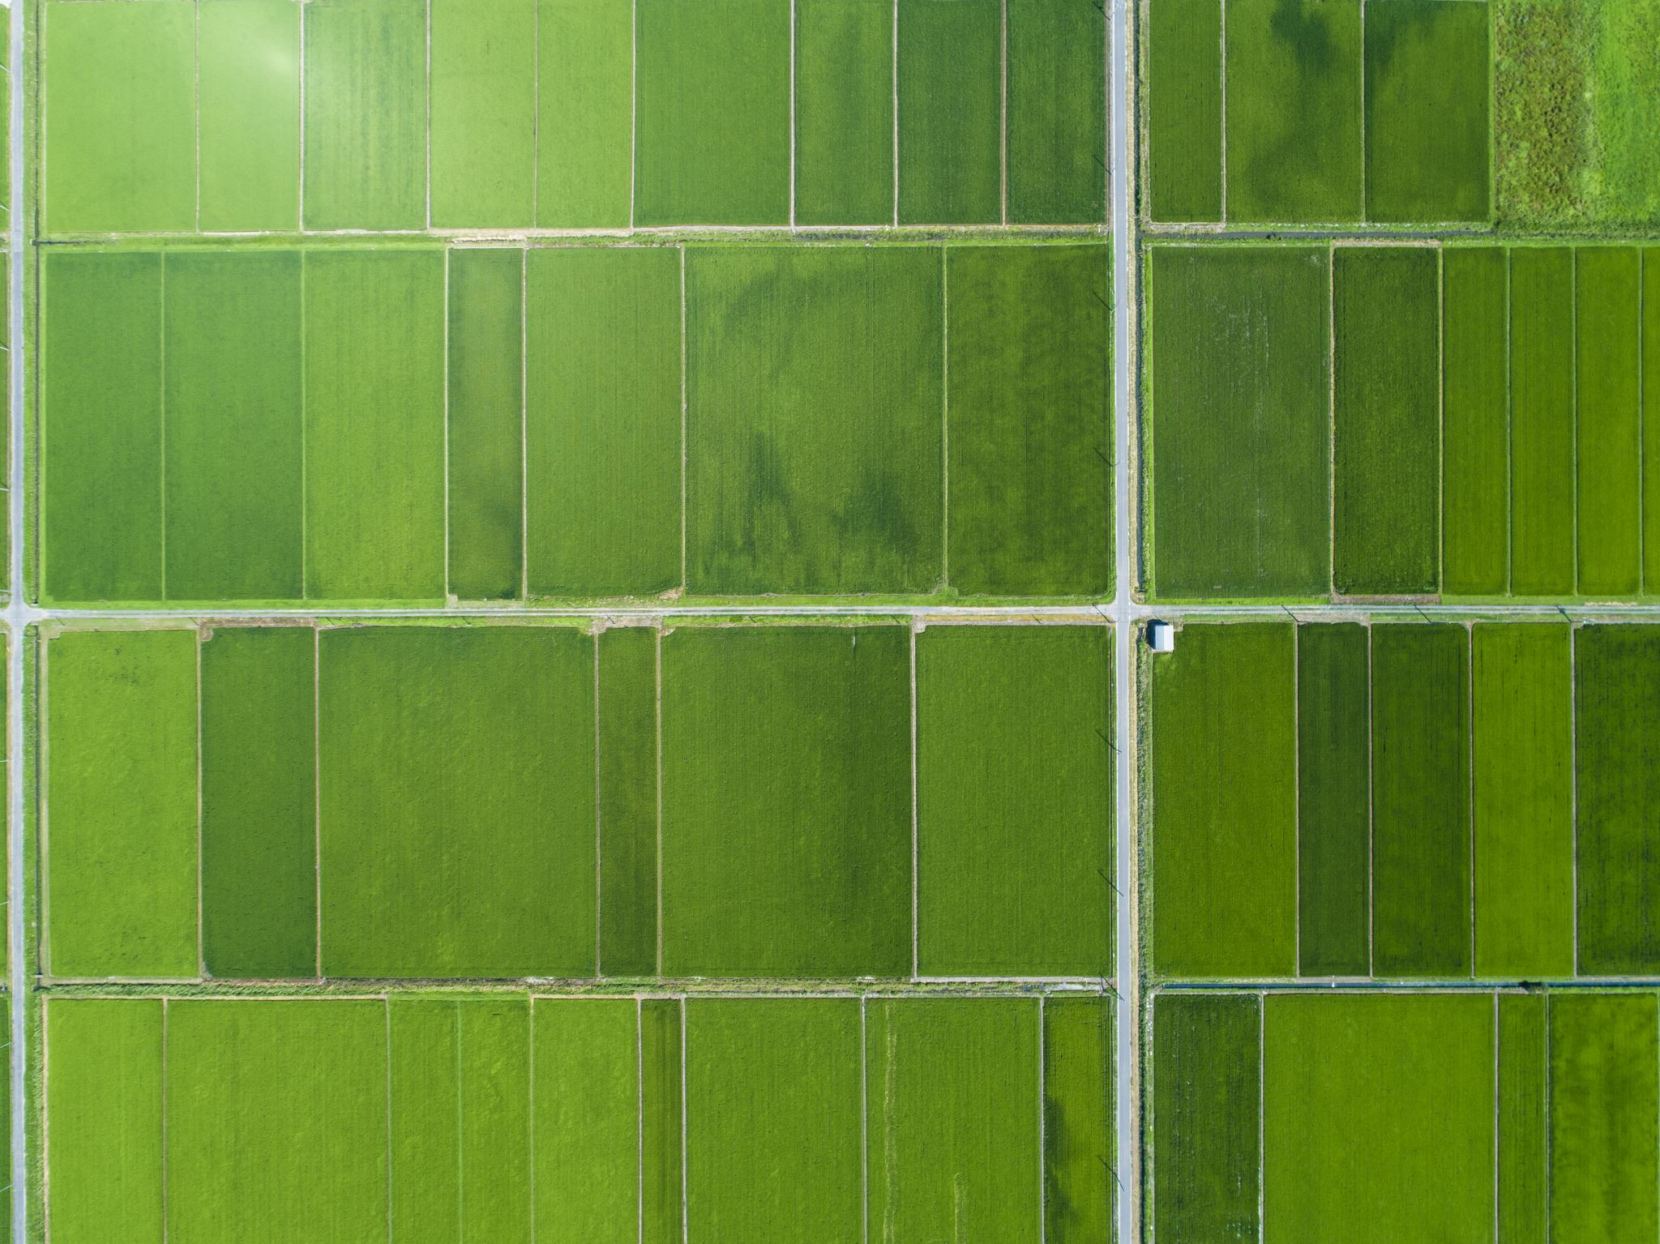
Smart agricultural management platform

Slide 4
AGENDA
Introduction
Problem Statement
Aims and Objectives
Proposed Solution
Project Plan
GANTT Chart
Risk Management
Functional and Non-Functional Requirements
Diagrams

Slide 5
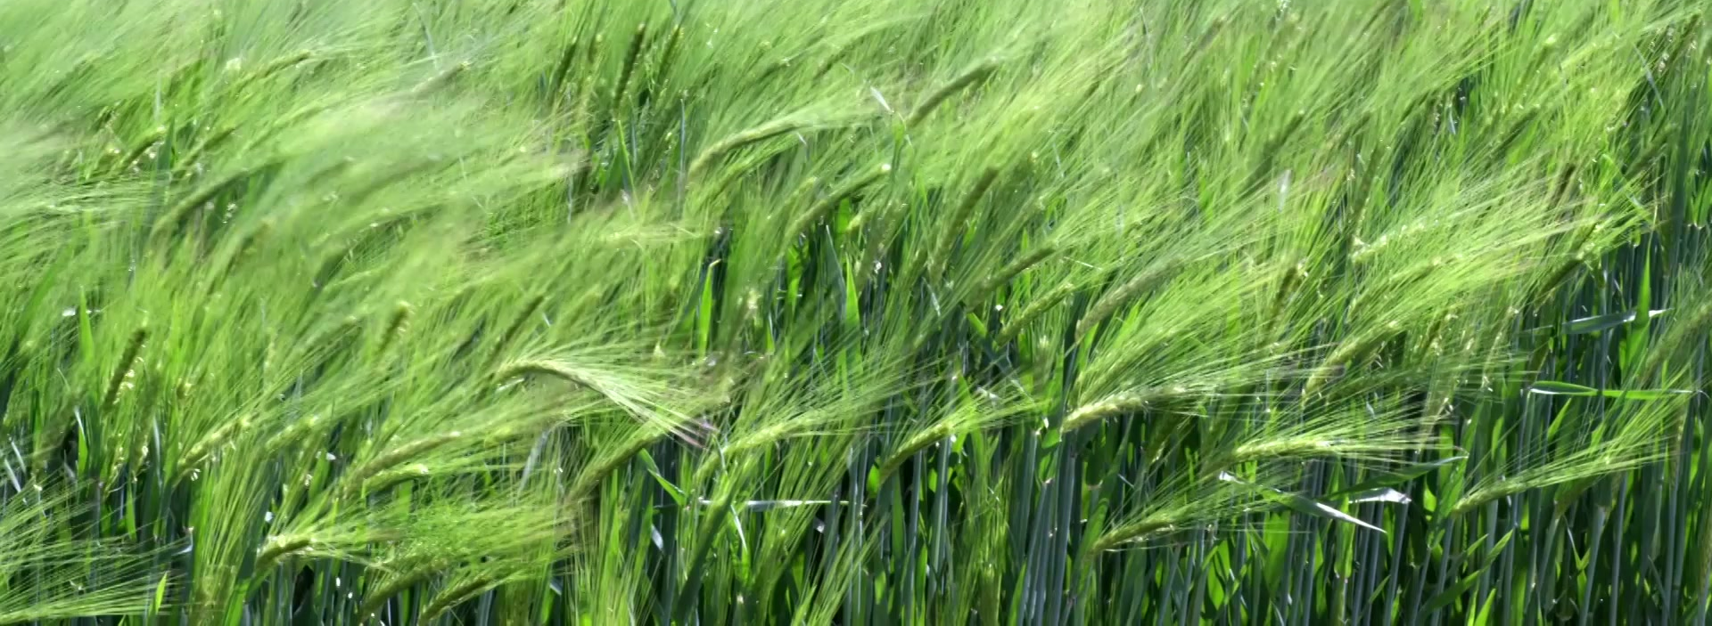
Introduction
The agricultural sector is one of the fundamental pillars of the Egyptian economy, serving as a primary source for food supply, job creation, and achieving food security. The importance of agriculture in Egypt spans across history, starting from the Pharaonic civilization, which relied on the Nile River and agriculture as a foundation for economic and social growth, to the present day, where the agricultural sector significantly contributes to the national GDP. However, the agricultural sector in Egypt faces major challenges that impact its efficiency and sustainability.

Slide 6
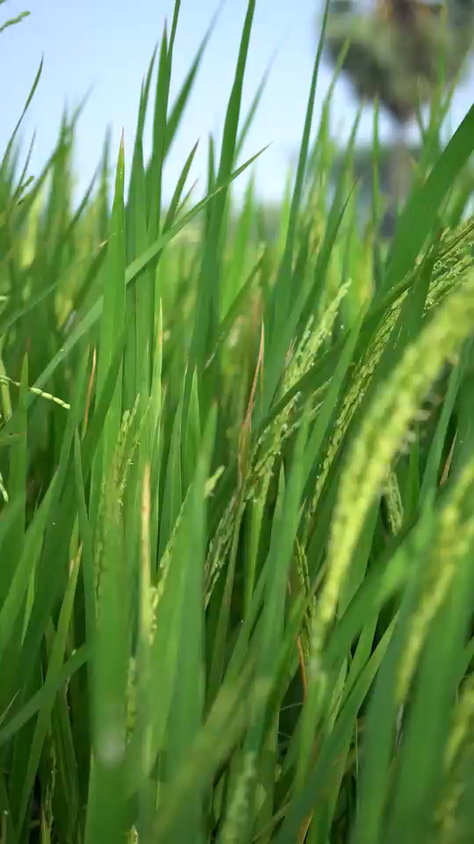
Problem Statement
Farmers face significant challenges, including inefficient resource management, unpredictable weather conditions, pest infestations, and a lack of real-time data to guide decision-making. Traditional farming methods often result in wasted resources, reduced yields, and environmental harm, while climate change intensifies these risks with unpredictable weather patterns. To address these issues, there is a pressing need for a smart agricultural management platform that leverages IoT devices, AI, and weather analytics to provide real-time insights, predictive alerts, and actionable recommendations, enabling farmers to optimize resource use, enhance productivity, and adopt sustainable farming practices.

Slide 7
Aims and Objectives
Aims:
To develop an intelligent agricultural management platform that empowers farmers and agricultural businesses to optimize resource usage, enhance productivity, and adopt sustainable farming practices through real-time data insights, predictive analytics, and AI-driven recommendations.
Objectives:
Real-Time Monitoring and Optimization: Use IoT devices and AI to track soil conditions, crop health, and resource usage, providing actionable insights to optimize water, fertilizers, and pest control.
Predictive Alerts and Recommendations: Integrate weather data and AI-driven recommendations to proactively address risks and improve productivity with tailored suggestions.
User-Friendly, Scalable Solutions: Provide an intuitive dashboard for decision-making and scalable tools that cater to both individual farmers and large agricultural businesses, promoting sustainability.

Slide 8
Proposed Solution
The proposed solution is a smart agricultural management platform that leverages IoT devices, AI, and weather analytics to address key farming challenges. The platform enables real-time monitoring of soil, crop health, and environmental conditions through IoT sensors, while AI-driven analytics provide tailored recommendations for irrigation, fertilization, and pest control. It integrates predictive alerts based on weather forecasts to help farmers proactively mitigate risks such as extreme weather or infestations. With tools to optimize resource usage and promote sustainable practices, the platform offers a user-friendly dashboard accessible across devices, catering to both small-scale farmers and large agricultural enterprises. This solution empowers farmers to enhance productivity, reduce costs, and adopt eco-friendly farming methods.

Slide 9

Project Plan
Research & Analysis (1-2 Months): Identify farmers' needs and define features.
Design & Prototyping (2-3 Months): Create wireframes, architecture, and a clickable prototype.
Development (4-6 Months): Build backend (APIs, database), frontend (UI, data visualization), and AI modules.
Testing (2 Months): Test IoT integration, functionality, and user acceptance.
Deployment (1 Month): Launch platform on cloud and app stores with training.
Maintenance (Ongoing): Provide support, gather feedback, and update regularly.
Timeline: 10-14 months Milestones: Design, IoT integration, AI deployment, prototype, full launch.

Slide 10
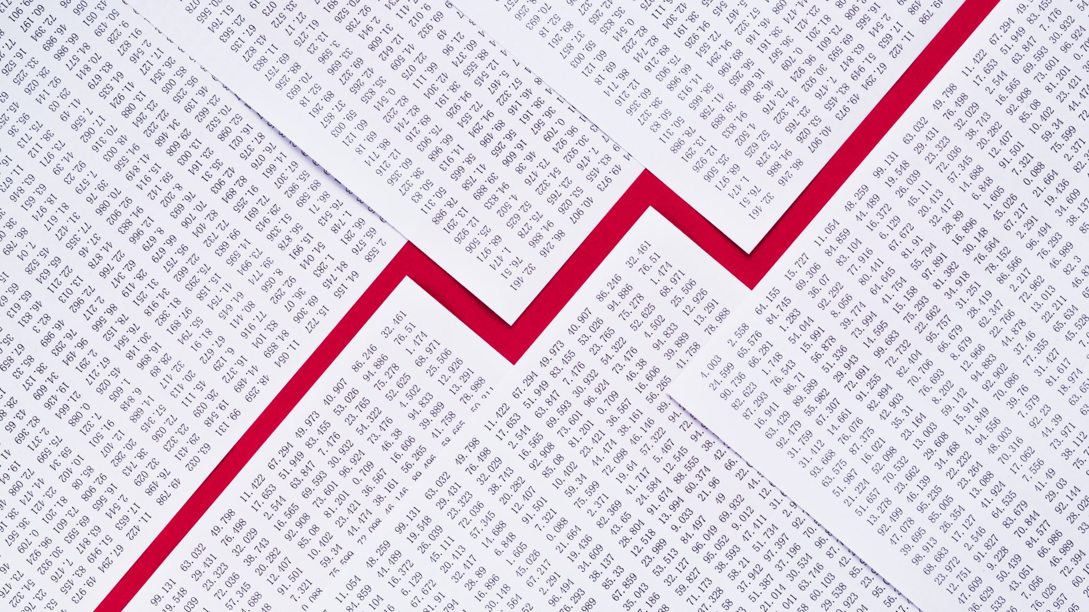
GANTT Chart

Slide 11
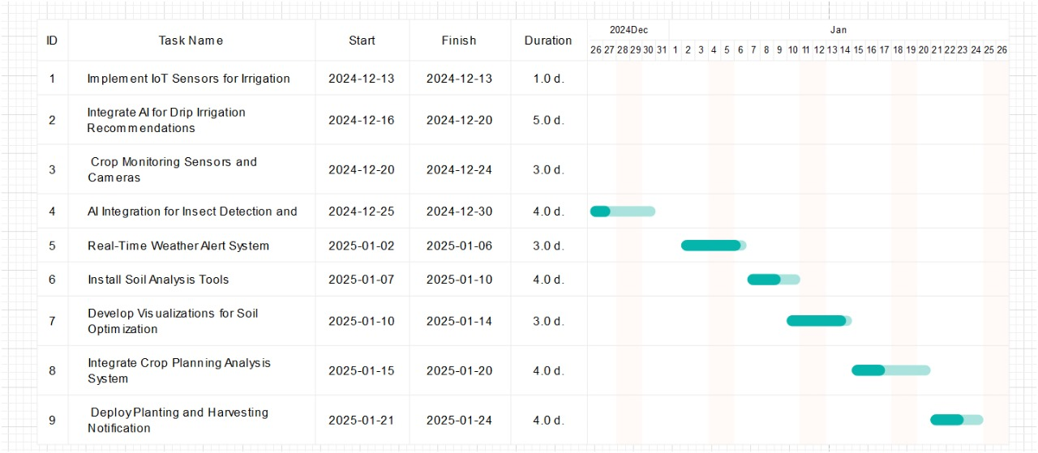

Slide 12

Risk Management
Technical Risks: Test rigorously and maintain quality standards.
Data Security: Implement encryption and compliance protocols.
Financial Risks: Create a detailed budget with contingency funds.
Adoption Challenges: Provide training, support, and free trials.
Market Risks: Differentiate with unique features and stay market-aligned.
Environmental Risks: Use durable IoT hardware and fallback systems.
Scalability: Use scalable cloud infrastructure.
Regulatory Issues: Ensure compliance with laws and regulations.
External Data Dependency: Partner with reliable providers for redundancy.

Slide 13

Functional and Non-Functional Requirements

Slide 14
Functional Requirements:
1. Moisture Level Monitoring: Utilization of IoT sensors to measure soil moisture and alert farmers of optimal irrigation times.
2. Pest Detection and Management: Integration of sensors and cameras to monitor crops for pest activity and use AI for early detection and management suggestions.
3. Weather Alert System: Real-time weather updates and notifications to farmers, enabling prompt responses to climatic changes.
4. Soil Quality Analysis: Continuous analysis of soil data, such as nutrient levels and pH, to provide targeted fertilizer recommendations.
5. Crop Planning Advisory: Utilization of soil and climate data to advise on suitable crop types for various seasons and guide on planting and harvesting schedules.

Slide 15
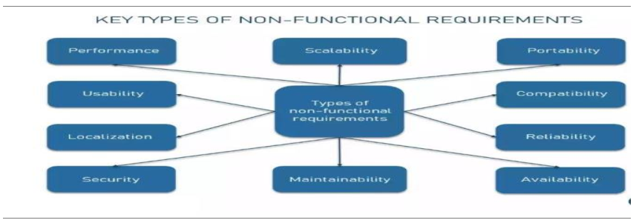

Slide 16
Non-Functional Requirements:
Scalability: The system must efficiently handle increasing data volumes from sensors as the number of users grows.
Security: Ensuring data integrity and security, particularly for users' agricultural data.
Usability: The interface should be user-friendly for non-technical users, facilitating easy access to platform features.
Performance: The platform should perform real-time data processing and alerts with minimal latency.
Reliability: The system should be operational with minimal downtime and capable of recovering quickly from any breakdowns.
Maintainability: Code and system architecture should be designed for easy maintenance and updates

Slide 17
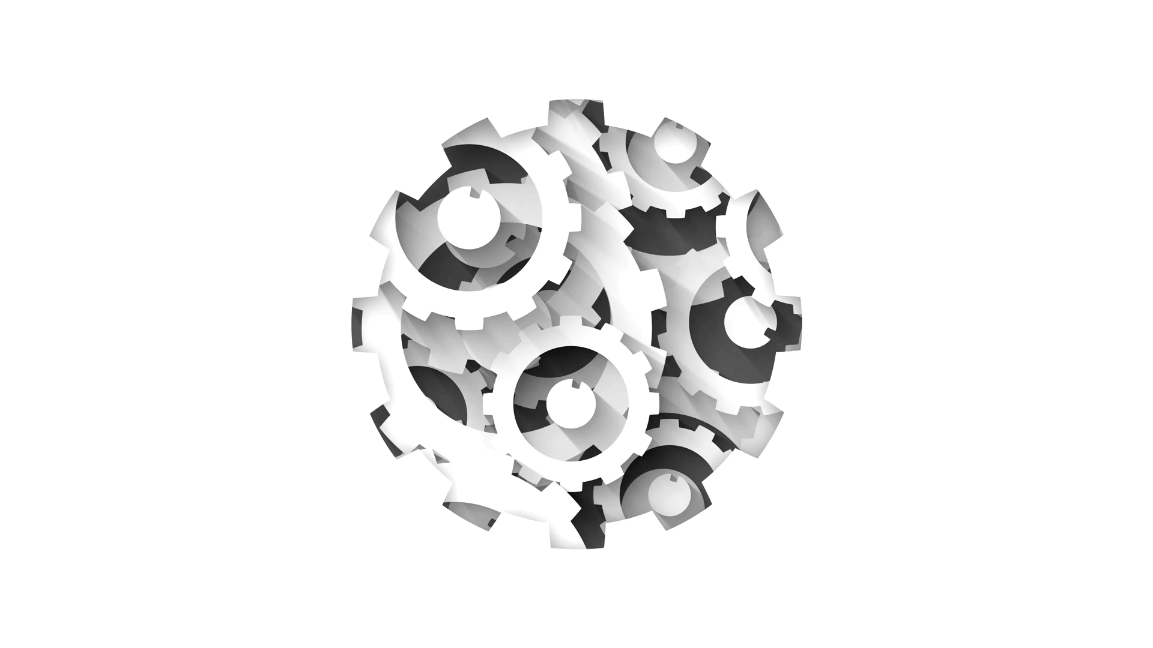
Diagrams

Slide 18
Class diagrams

Slide 19
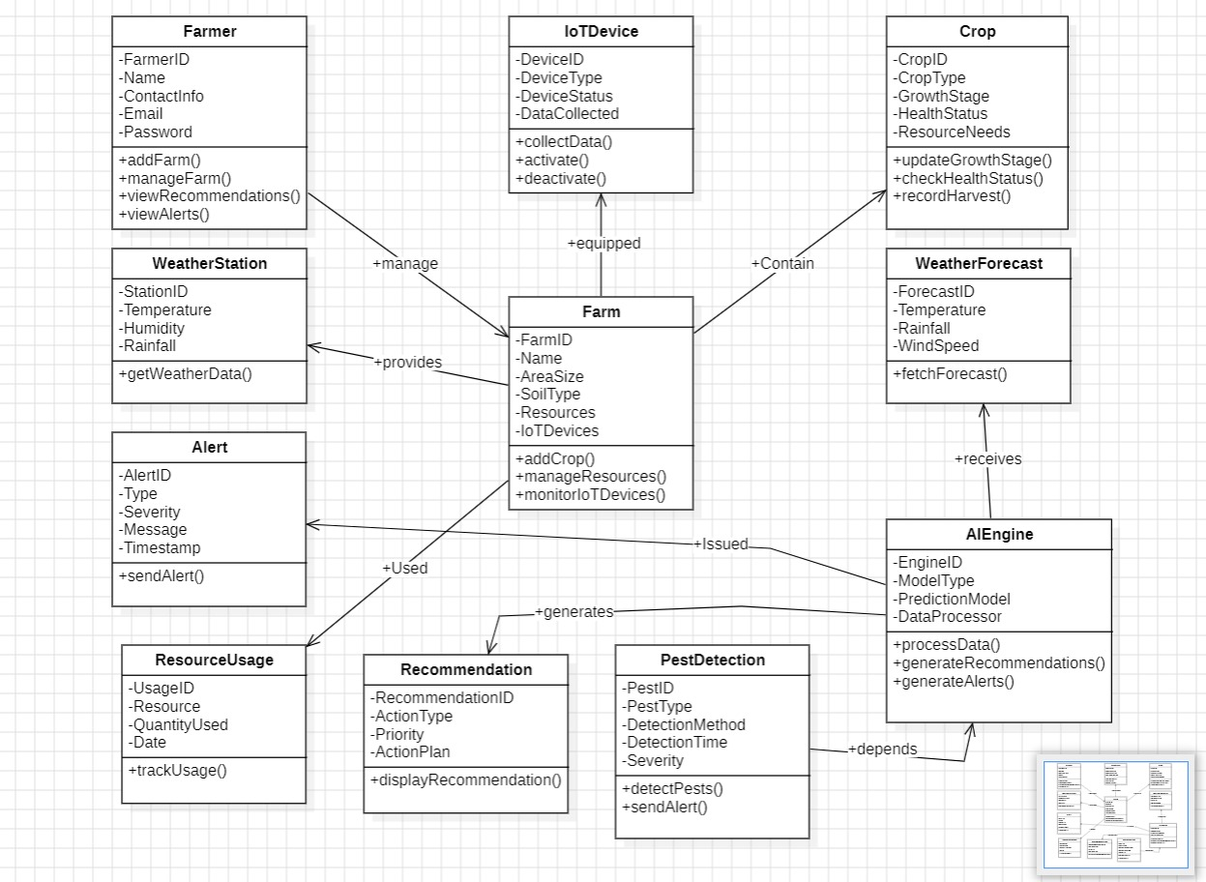

Slide 20
Relationships
Farmer → Farm: A farmer manages one or more farms.
Farm → Crop: A farm contains multiple crops.
Farm → Resource: A farm uses multiple resources (water, fertilizer, etc.).
Farm → IoT Device: A farm is equipped with various IoT devices to collect data.
Farm → Weather Station: Each farm has a weather station that provides real-time weather data.
IoT Device → Data Collection: IoT devices collect data that is used for monitoring and decision-making.
Weather Forecast → AI Engine: The weather forecast data is processed by the AI engine.
AI Engine → Recommendation: AI generates recommendations for farmers based on processed data.
AI Engine → Alert: AI generates alerts based on predictive models and real-time data.
Pest Detection → IoT Device: Pest detection is triggered by IoT sensors or image recognition systems.

Slide 21
Relationships | Kind
Farmer → Farm | One-to-Many
Farm → Crop | One-to-Many
Farm → Resource | Many-to-Many
Farm → IoTDevice | One-to-Many
Farm → WeatherStation | One-to-One
IoTDevice → DataCollection | One-to-Many
WeatherForecast → AIEngine | Many-to-One
AIEngine → Recommendation | One-to-Many
AIEngine → Alert | One-to-Many
PestDetection → IoTDevice | Many-to-Many

Slide 22
Sequence diagrams

Slide 23
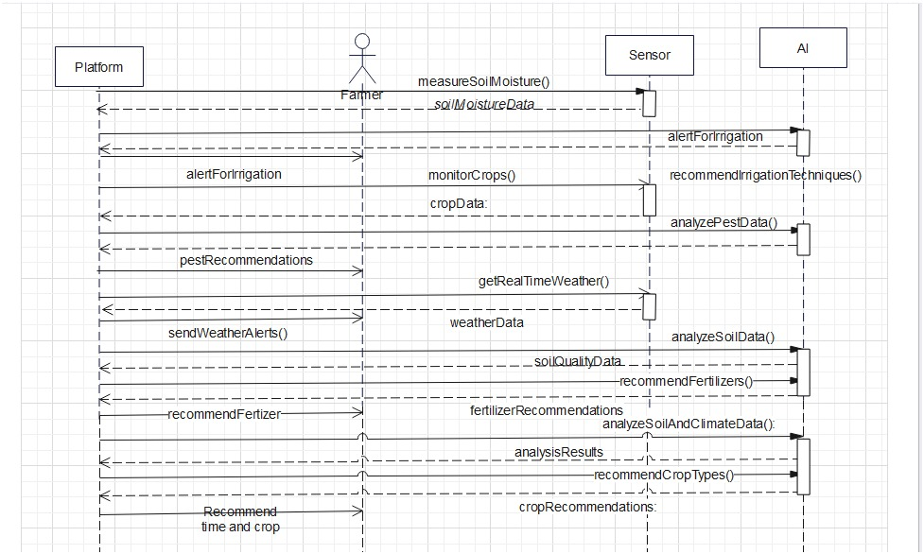

Slide 24
State diagrams

Slide 25
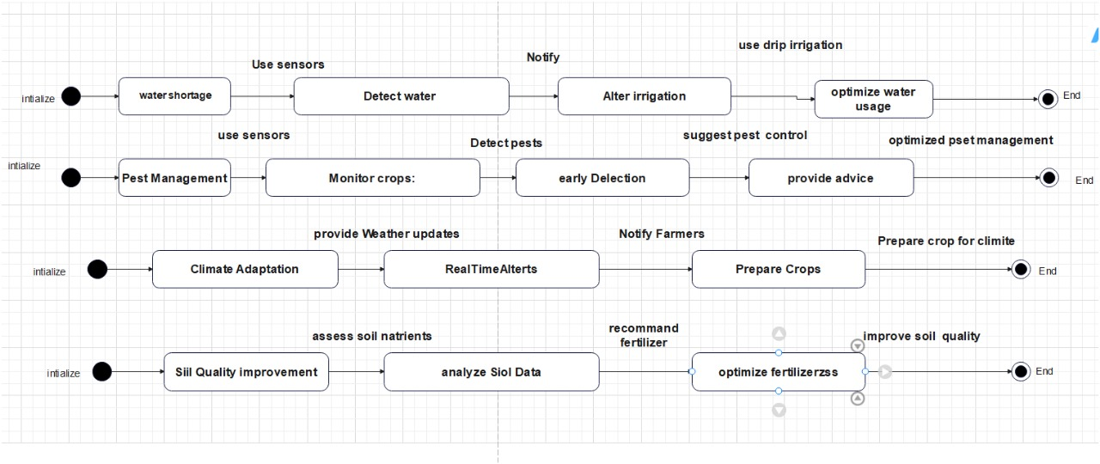

Slide 26
Use Case diagrams

Slide 27
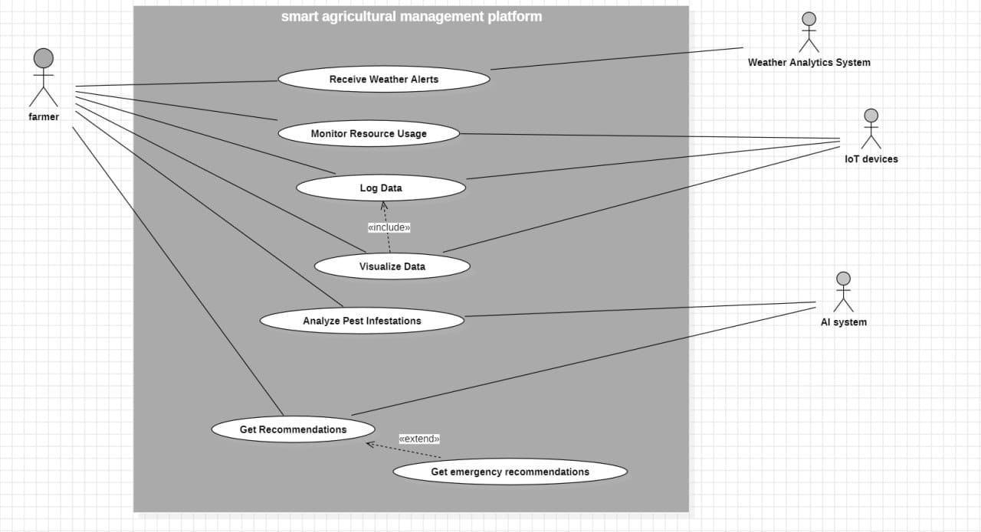

Slide 28
Activity diagrams

Slide 29
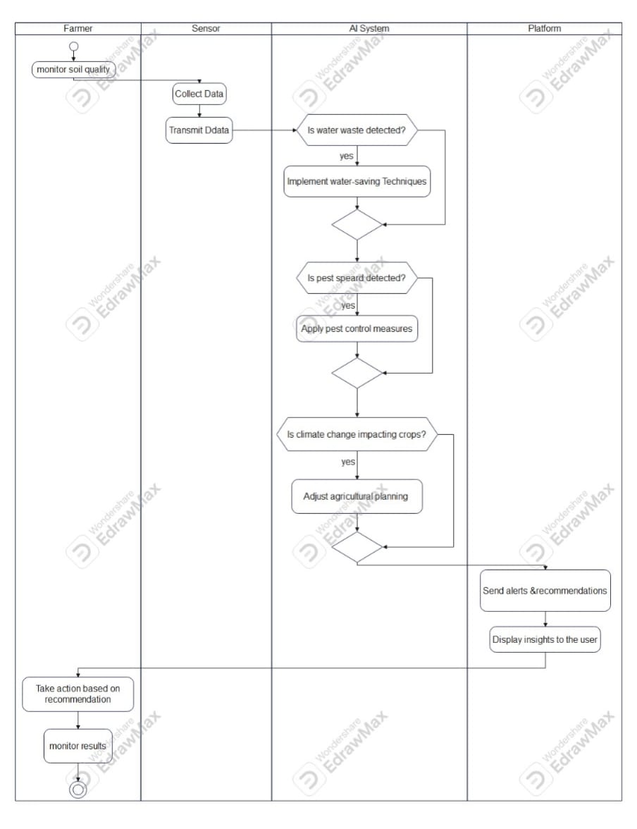

Slide 30
Component diagrams

Slide 31
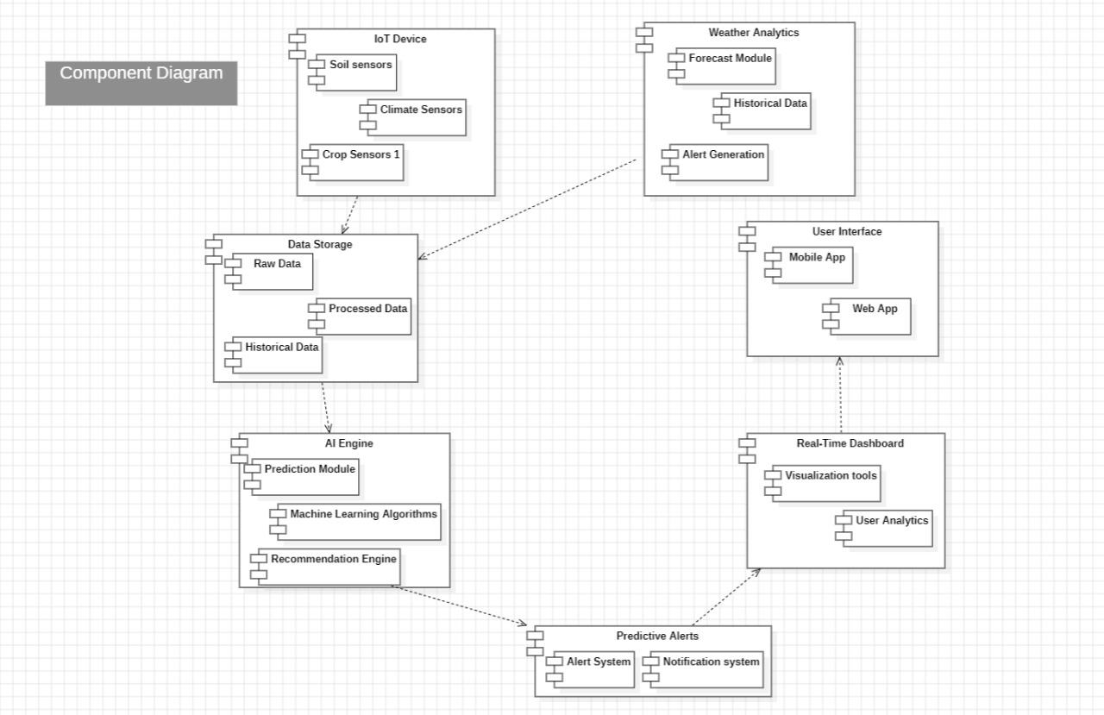

Slide 32
Deployment diagrams

Slide 33
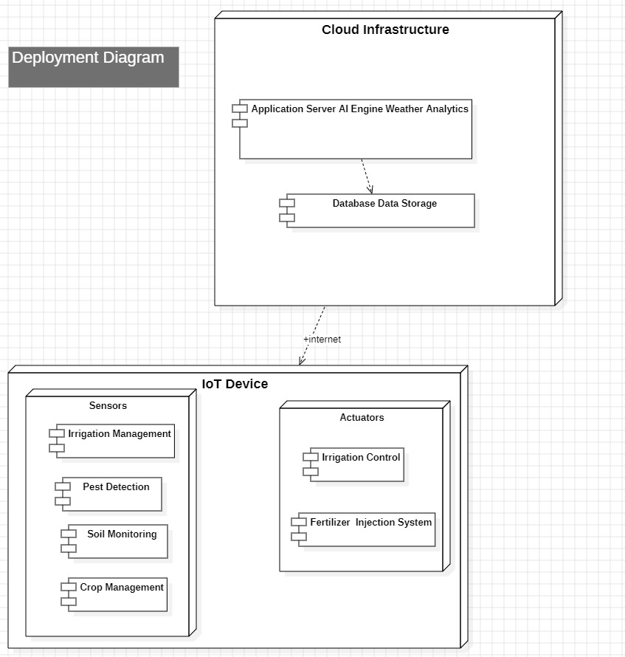

Slide 34
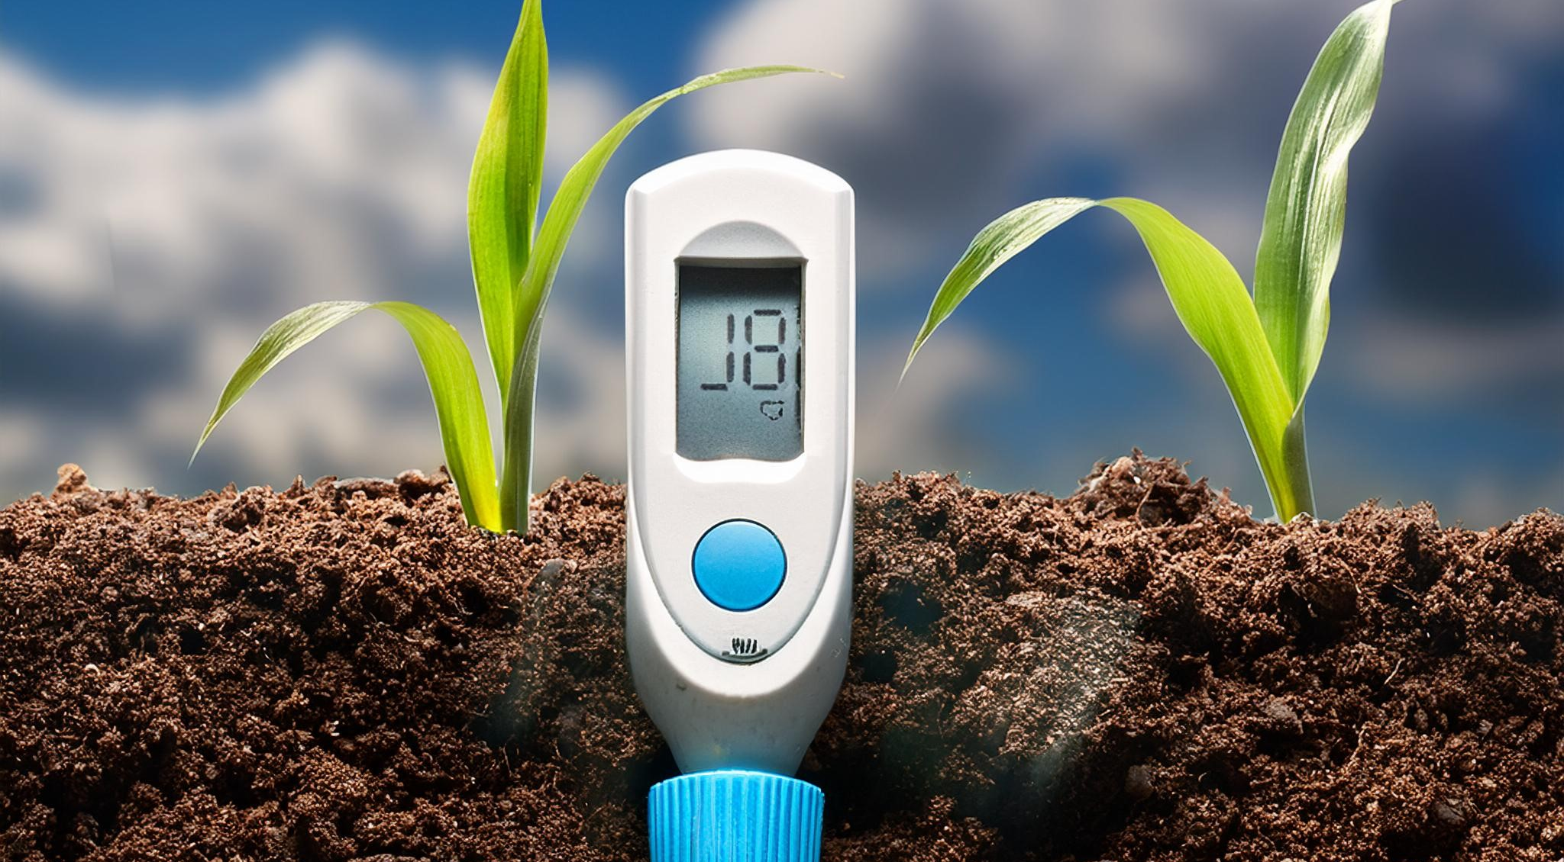

Slide 35
Thank You
For Your Attention

